Slide 1
TestQua31 Appium Project
Automated Mobile Testing with Python
Bridget D. Narte
Jiesel Badayos
Dodie Jaca
Mark Tabanas

Slide 2


Introduction to Automated Testing
Automated mobile testing with Appium and Python streamlines the process of validating applications, ensuring efficiency and accuracy while improving deployment speed in the testing phase.

Slide 3
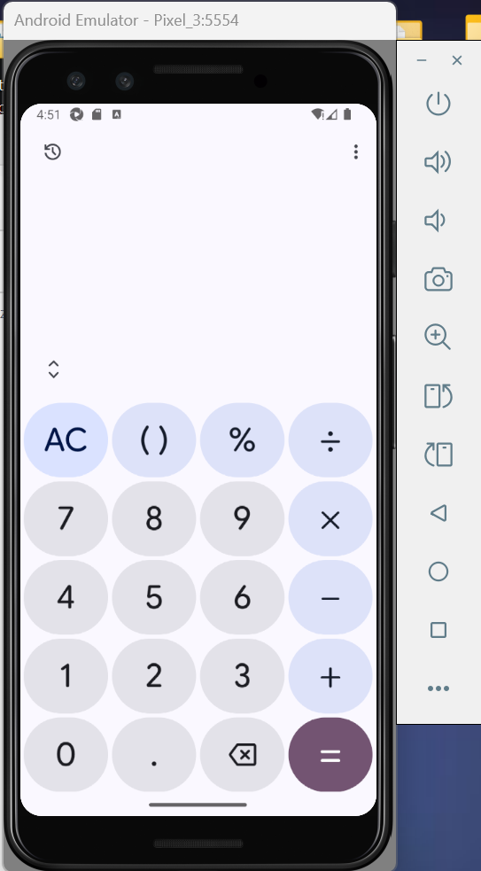
Project Goal
The primary goal of this project is to automate testing for the Google Calculator app on an Android emulator, showcasing efficiency and capabilities of Appium and Python.

Slide 4

Python 3.13+
Required for running Appium and test scripts.
Prerequisites
Appium Desktop 3.x
Essential tools for mobile testing setup
Necessary to set up the automation server.
Android Emulator
Simulates the Android environment for testing apps.
Java JDK 8+
Provides necessary libraries for running Appium tests.

Slide 5

Create and Activate Environment
Setting up a Python virtual environment ensures your project dependencies are isolated. This step simplifies package management and avoids conflicts, facilitating a smoother development experience.

Slide 6
Install Dependencies
In this section, we will detail the process of installing necessary dependencies , ensuring a smooth setup for our automated testing environment.

Slide 7
Starting Tests
To initiate your testing process, first start the Android emulator (Pixel 3 recommended), then launch the Appium Desktop server at http://127.0.0.1:4723/wd/hub to establish the testing environment.

Slide 8
Execute Tests
To run the tests, start by executing the command pytest -v test_calculator.py in the terminal. This will provide detailed feedback on each test's performance and results.

Slide 9
Addition Test
Verifies basic addition works correctly by calculating 7 + 8 and confirming the result is 15
Test Cases
Multiplication Test
Key Functionality of the Calculator App
Confirms that 6 × 7 results in 42 correctly.
Subtraction Test
Verifies basic subtraction works correctly by calculating 25 - 9 and confirming the result is 16
Division Test
Ensures that 20 ÷ 4 produces a result of 5.
Clear Button Test
Checks if the clear button resets the display correctly.
APK Inspect Test
Verifies APK activity and information.

